Slide 1
Testing
STW300CEM Android Applications Development

Slide 2
Contents
Test-Driven Development (TDD)
Local Unit test
Instrumented unit test
UI tests using Expresso

Slide 3
Testing
Write the test before you write the code.
Use tests to communicate unusual circumstances in which the
code should work.
Unit tests written by the developer.
Unit tests must always work at 100% in deployed code.

Slide 4
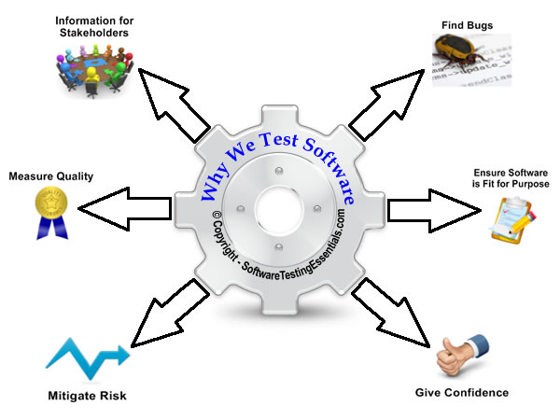
Test-Driven Development (TDD)

Slide 5
Why TDD ?
Thinking about what is the goal first and then the implementations.
Better understand the software behaviour.
Get quick feedback whether the software works.
There is no code without a test.
Use the written test as regression tests.
More courage to refactor.
Can save lots of time.

Slide 6
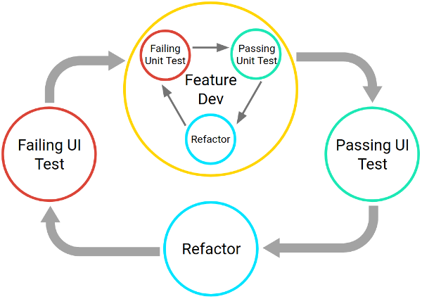
The TDD Process
Each new feature begins with writing a series of tests.
The developer must clearly understand the
user story to understand the requirements
and exception conditions.
Tests are typically written in the same
language as the code to be tested and are
organised into suites.
Tests are then run using an automated test
framework to make sure they fail.
Code is then written to make the tests pass.
The code is refactored to improve performance and readability.

Slide 7
How many tests?
Test at least one "typical" case (for example, 3+7==10).
However, if this is all you do, you are following the happy path
where everything is sweetness and light, everyone loves everyone
else, and mistakes never happen. In other words, this isn't good
enough! Your object is writing tests is not to "prove" your program
works, it's to try to find out where it doesn't!
Test every "extreme" case you can think of.
For example, if you were to write and test a function to sort a list,
some things you might consider are: What if the list contains some
equal numbers? Do the first and last elements get moved to the
correct position? Can you sort a 1-element list without getting an
error? How about an empty list?

Slide 8
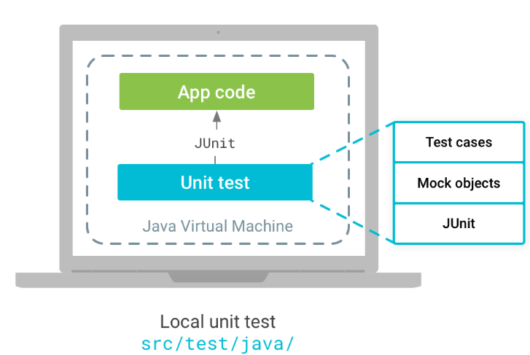
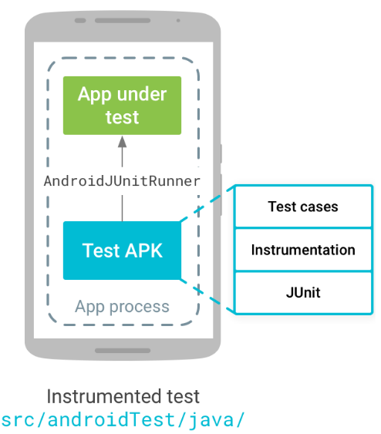
Testing types
Local unit test
Tests that run on your machine's
local Java Virtual Machine (JVM)
Instrumented test
Tests that run on a hardware
device or emulator

Slide 9
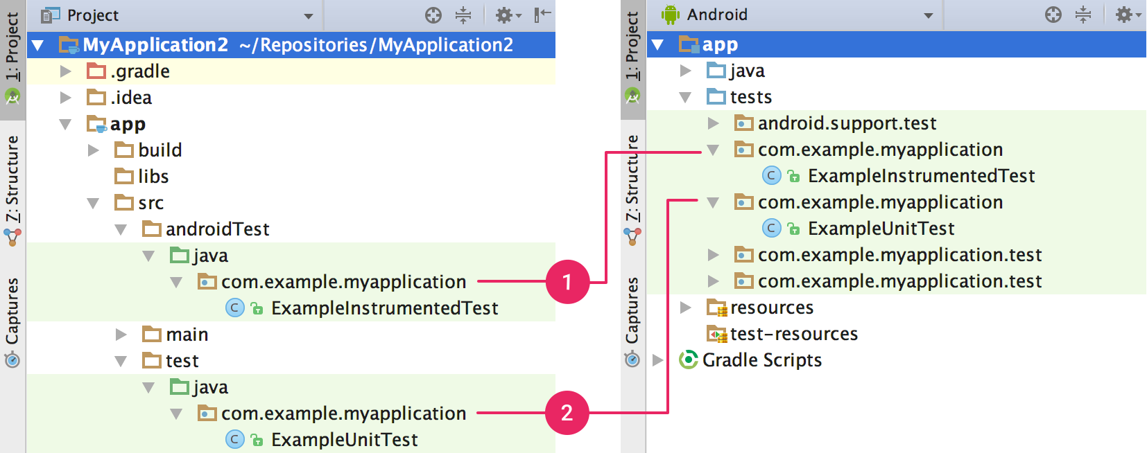
Your project's
(1) instrumented tests and
(2) local JVM tests are visible in either the Project view (left) or Android view (right).

Slide 10
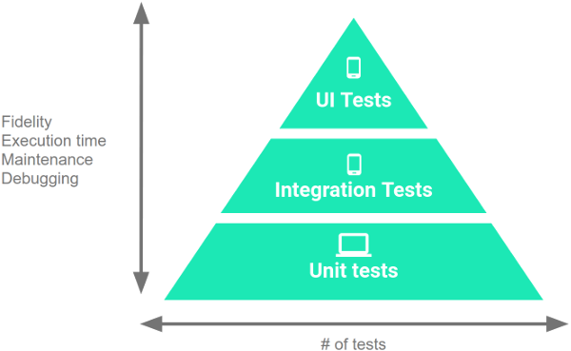
Levels of the Testing Pyramid
1. Small tests are unit tests that validate your app's behavior one class at a time.
2. Medium tests are integration tests that validate either interactions between levels of the stack within a module, or interactions between related modules.
3. Large tests are end-to-end tests that validate user journeys spanning multiple modules of your app.

Slide 11
Local Unit test

Slide 12
Unit Testing
Test individual units of a program.
Simplest way to think of it – test every function
No guarantee that the different functions work together
harmoniously
Need to do integration testing afterwards

Slide 13
Unit testing frameworks goals
To make it easy to write tests.
To make it easy to run tests.
To make it easy to tell if the tests passed.
To make it easy to identify where and why tests failed.
To not require any input from the user.
To separate logic from input/output.

Slide 14
JUnit4
JUnit is a unit testing framework for the Java programming language.
JUnit has been important in the development of test-driven development, and is one of a family of unit testing frameworks which is collectively known as xUnit that originated with SUnit.
Test is a class in JUnit.
The use of annotation and assertion.
Android uses JUnit 4, NOT JUnit 3/5.

Slide 15
JUnit – Basic annotation
@BeforeClass – Run once before any of the test methods in the class, public static void
@AfterClass – Run once after all the tests in the class have been run, public static void
@Before – Run before @Test, public void
@After – Run after @Test, public void
@Test – This is the test method to run, public void
@BeforeClass – Run once before any of the test methods in the class, public static void
@AfterClass – Run once after all the tests in the class have been run, public static void
@Before – Run before @Test, public void
@After – Run after @Test, public void
@Test – This is the test method to run, public void

Slide 16
JUnit Assert Methods
1. Boolean
If you want to test the boolean conditions (true or false), you can use following assert methods
assertTrue(condition)
assertFalse(condition)
2. Assert Equals
If you want to test equality of two objects, you have the following methods
assertEquals(expected, actual)

Slide 17
3. Assert Array Equals
If you want to test equality of arrays, you have the following methods as given below:
assertArrayEquals(expected, actual);
4. Fail Message
If you want to throw any assertion error, you have fail() that always results in a fail verdict.
Fail(message);

Slide 18
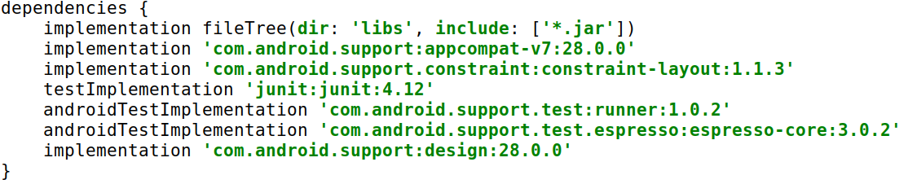
build.gradle

Slide 19
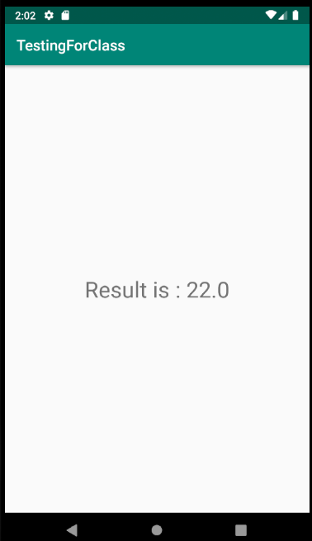
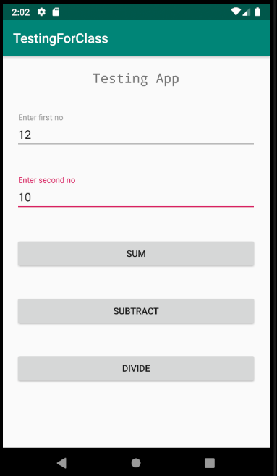
Sample App

Slide 20
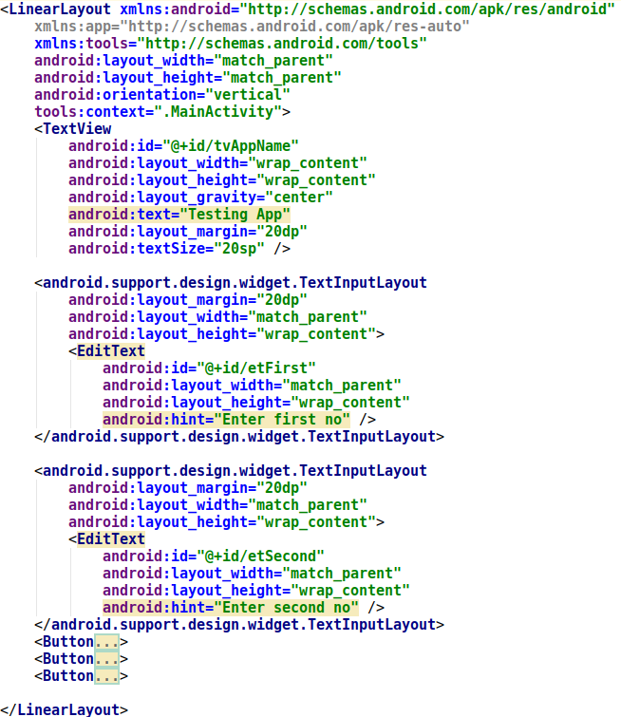
XML

Slide 21
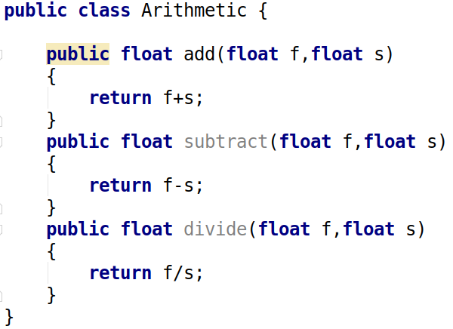
Arithmetic class

Slide 22
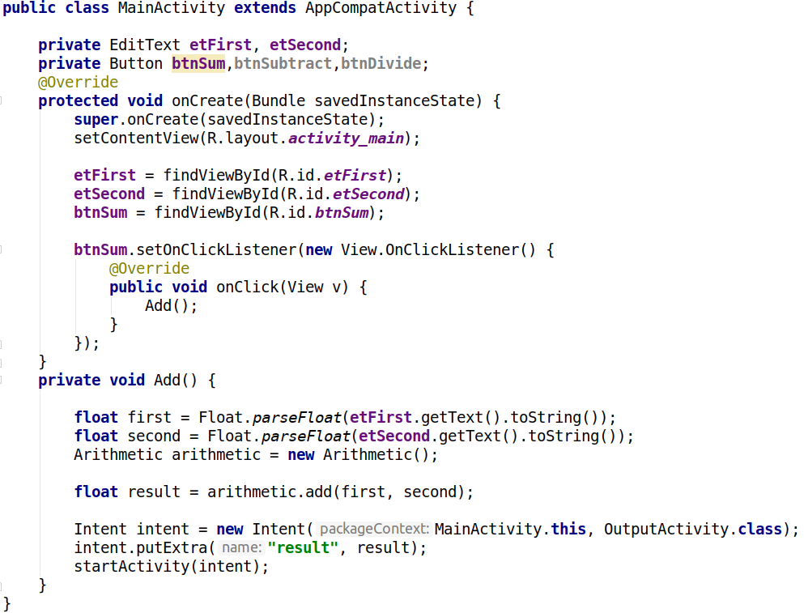
Activity

Slide 23
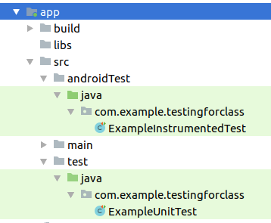
Unit test
create a class named
ArithmeticTest for testing
Arithmetic class

Slide 24
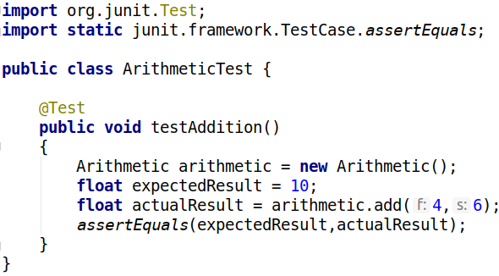
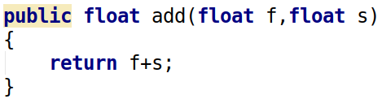
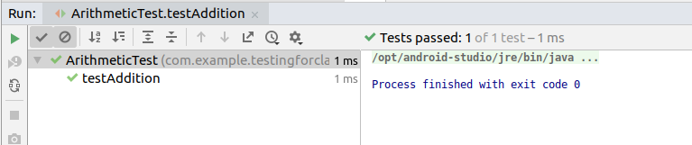
Testing Example - 1
to run test
right-click - > run
or
ctrl + shift + f10

Slide 25
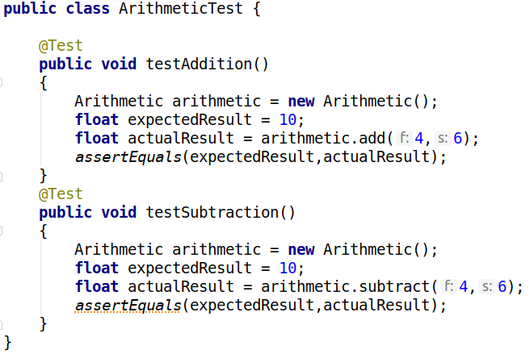
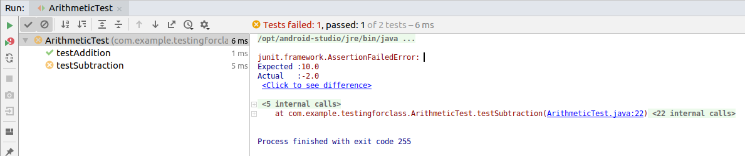
Testing Example - 2
Run multiple test click outside
the function and
right-click -> run
or
ctrl + shift + f10
Test passed
Test failed

Slide 26
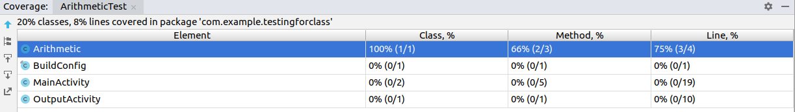
Coverage
The higher coverage the better.
Show it in your video.

Slide 27
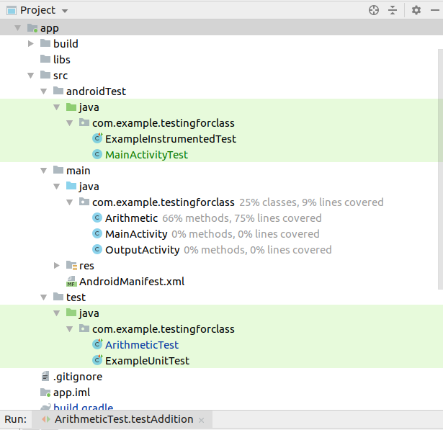

Slide 28
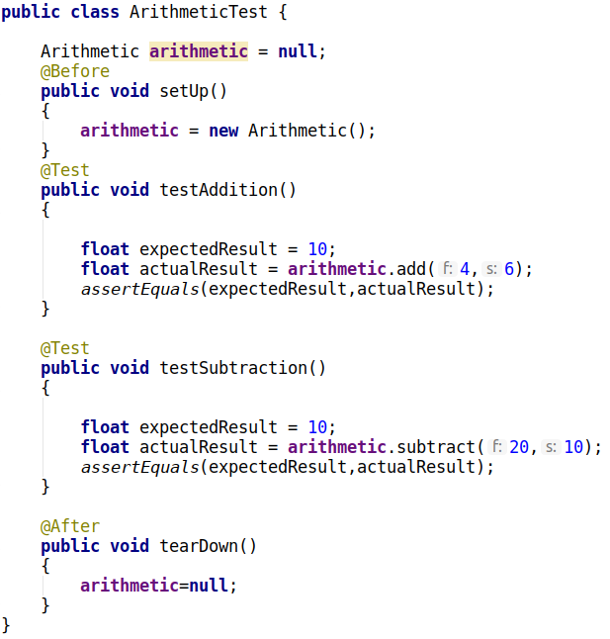
@Before and @After

Slide 29

Espresso
The Espresso tests are classes that are separate from your app's code. You can create as many tests as you need in order to interact with the View elements in your UI that you want to test.
The Espresso test is like a robot that must be told what to do. It must find the View you want it to find on the screen, and it must interact with it, such as clicking the View, and checking the contents of the View.If it fails to do any of these things properly, or if the result is not what you expected, the test fails.
The key concepts are locating and then interacting with UI elements. These are the basic steps:
Match a View: Find a View
Perform an action: Perform a click or other action that triggers an event with the View
Assert and verify the result: Check the state of the View to see if it reflects the expected state or behavior defined by the assertion.

Slide 30
Anatomy of UI Test
1. Find a View
2. Perform an Action
3. Inspect the result

Slide 31
Anatomy of UI Test
OnView(Matcher<View>)
2. Perform an Action
3. Inspect the result

Slide 32
Anatomy of UI Test
OnView(Matcher<View>)
.perform(ViewAction)
3. Inspect the result

Slide 33
Anatomy of UI Test
OnView(Matcher<View>)
.perform(ViewAction)
.check(ViewAssertion)

Slide 34
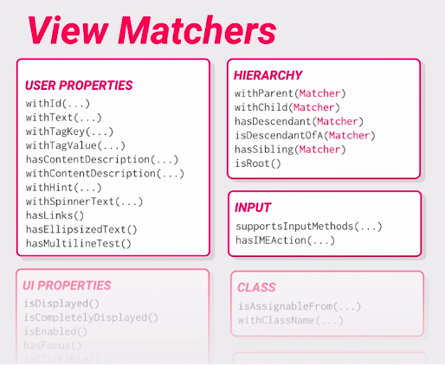
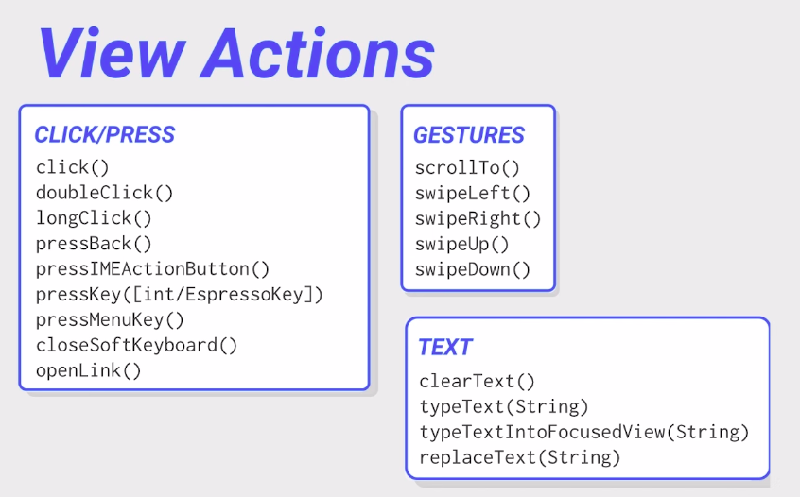
View Matchers and View Actions

Slide 35
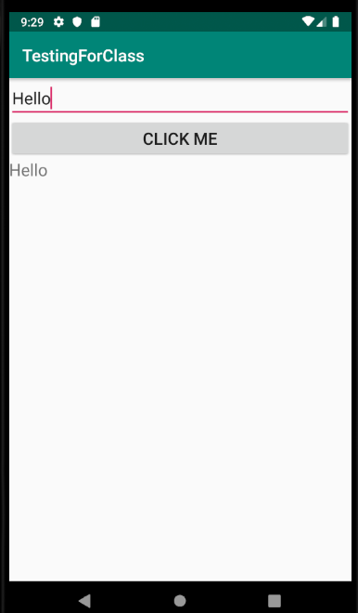
Just displaying EditText value
in TextView on button click.
We will automate this test
using Espresso.

Slide 36
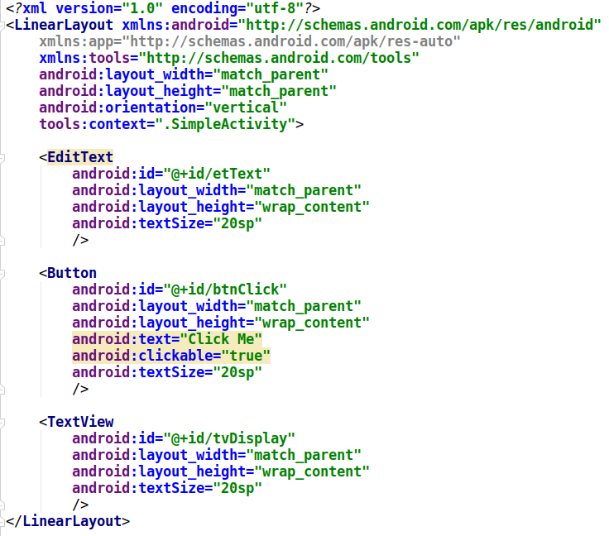
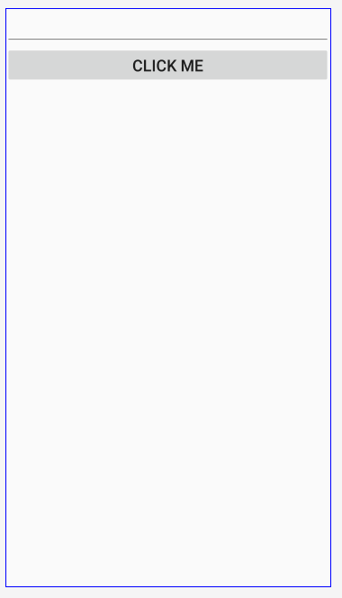
XML

Slide 37
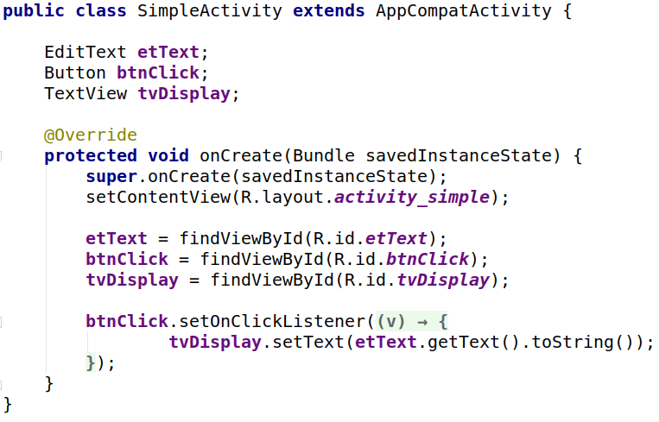
Activity Code

Slide 38
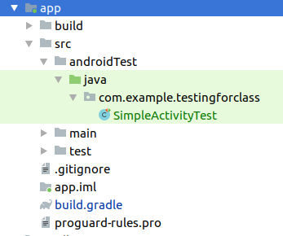
Instrumented Test
Create a class SimpleActivityTest
for testing SimpleActivity activity

Slide 39
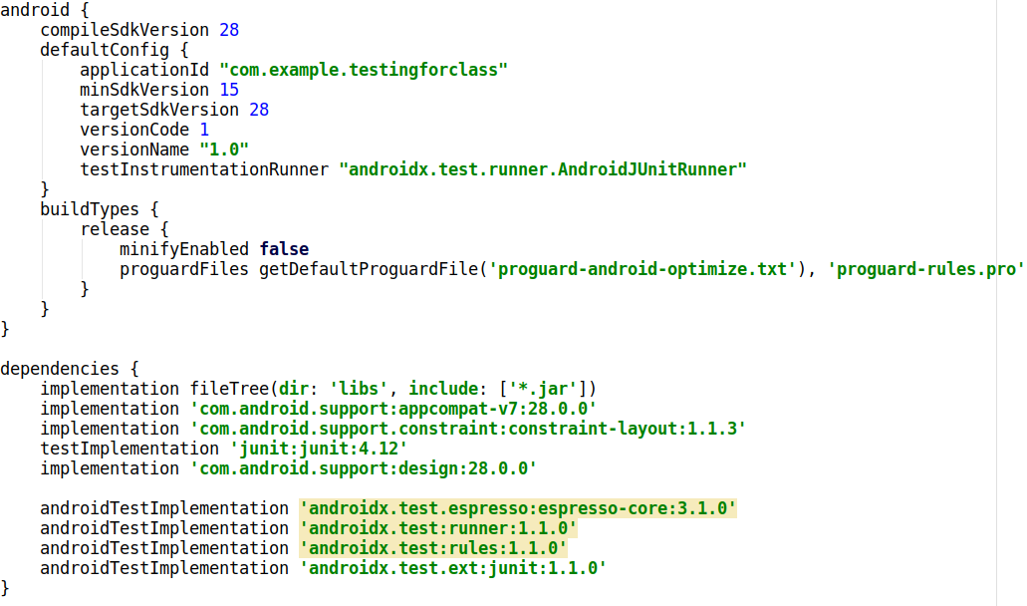
build.gradle
Replace this with the previous one

Slide 40
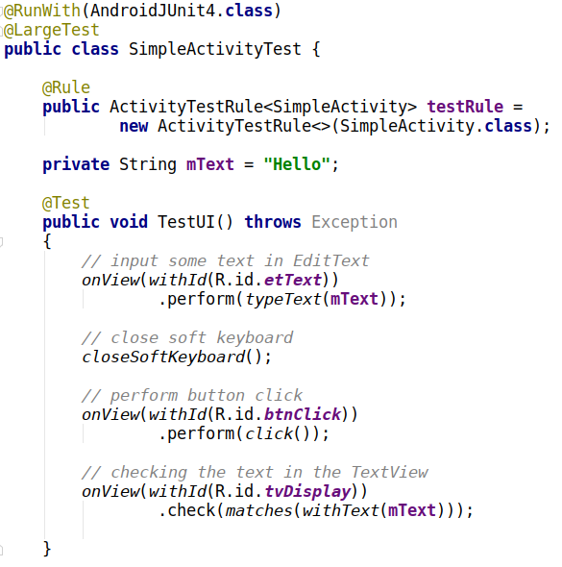

Slide 41
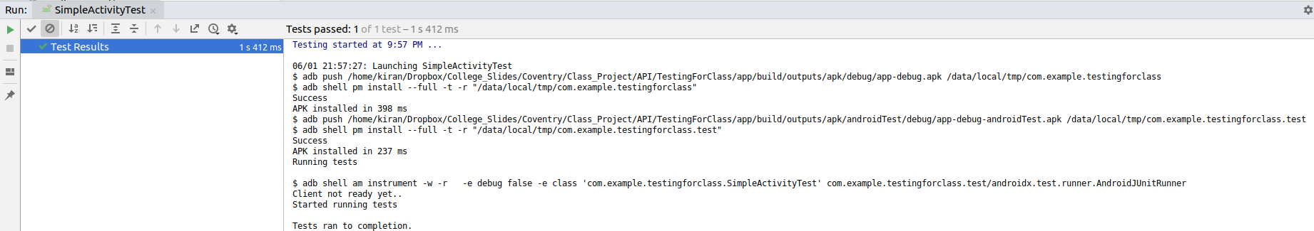
output
Emulator will run the application and perform all the task which we have told and after finishing testing it will show this window.

Slide 42
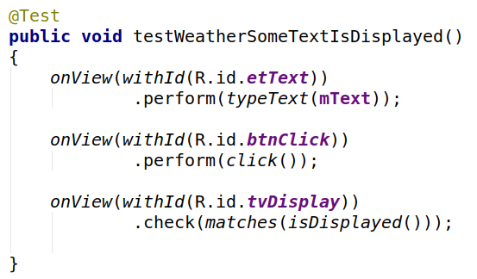
Check Weather some text is displayed or not

Slide 43
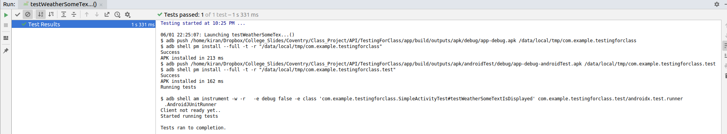
Output

Slide 44
Testing multiple activity

Slide 45
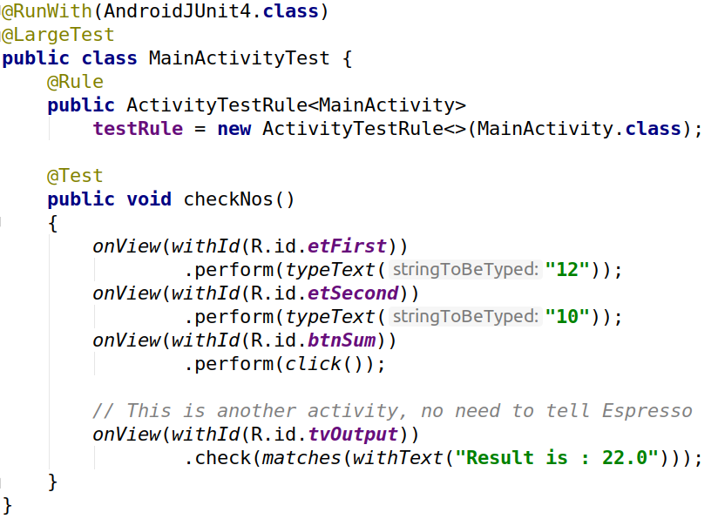

Slide 46
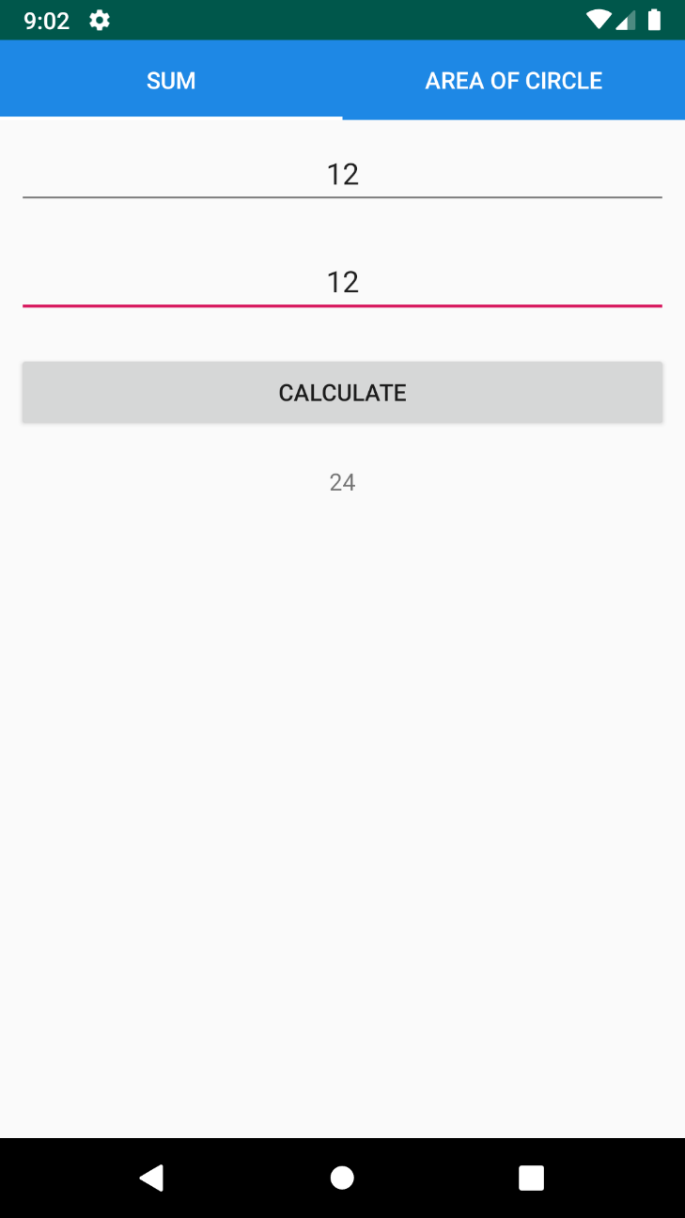
Testing fragment using espresso

Slide 47
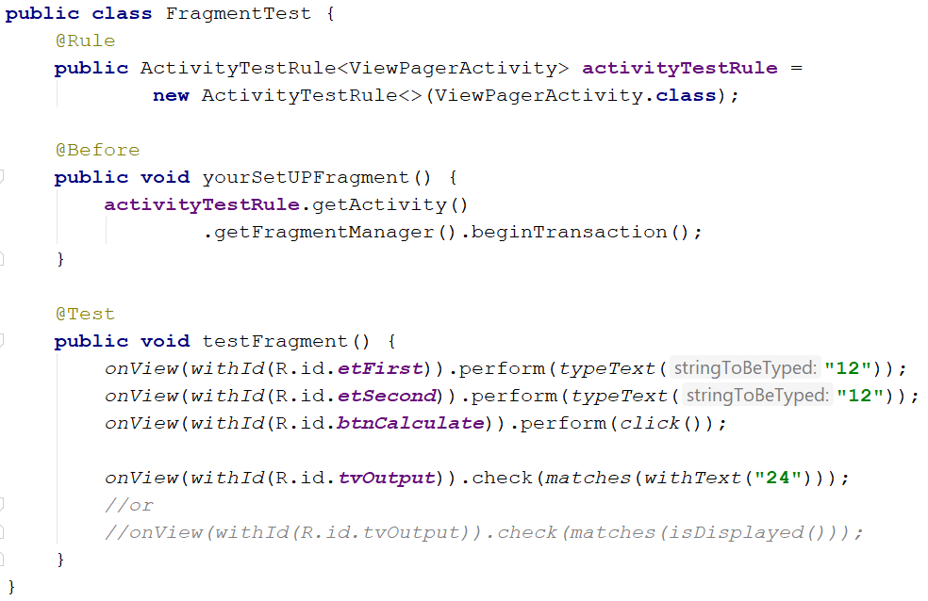
Instrumented test

Slide 48
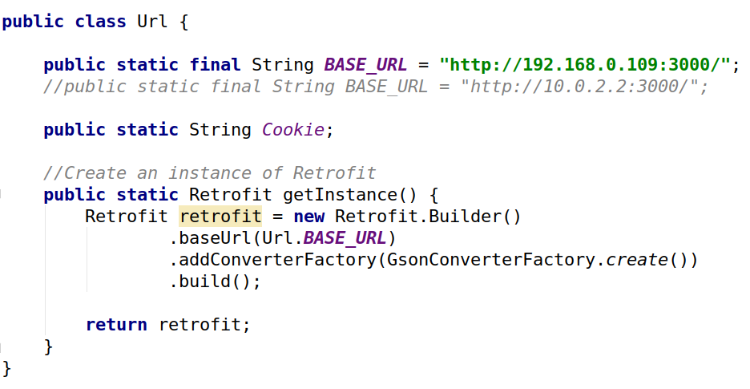
Running app in mobile device and accessing server data locally
Your laptop IP address

Slide 49
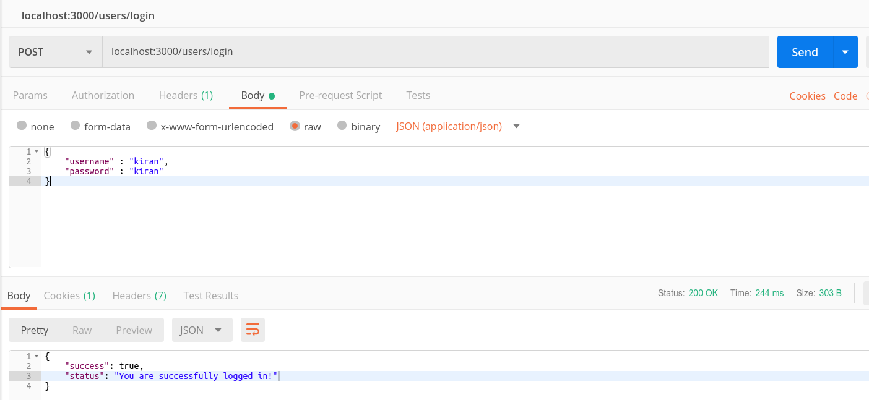
Testing API data

Slide 50
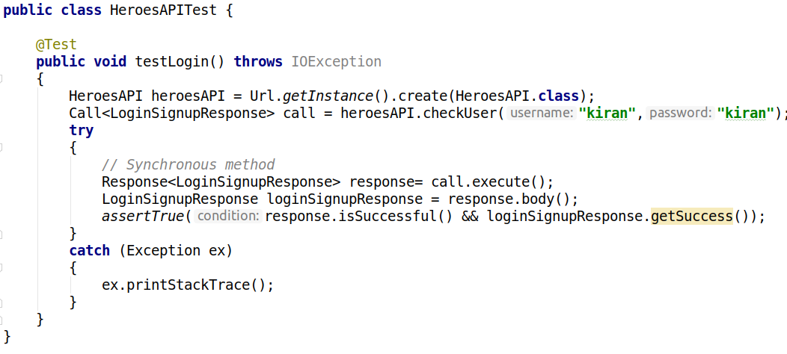
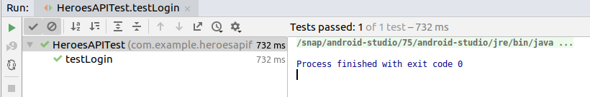
Testing login

Slide 51
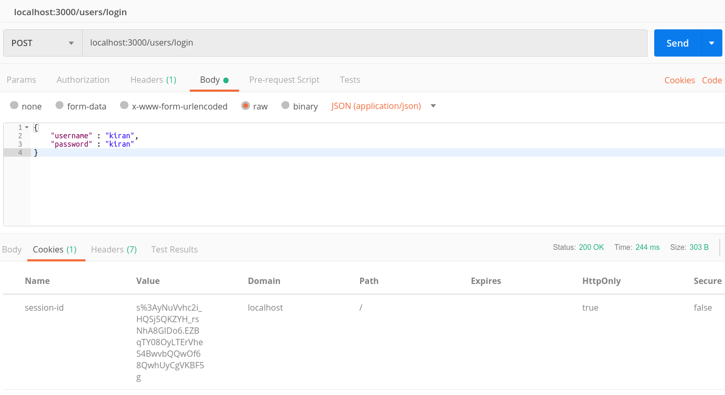
Check for cookies after login

Slide 52
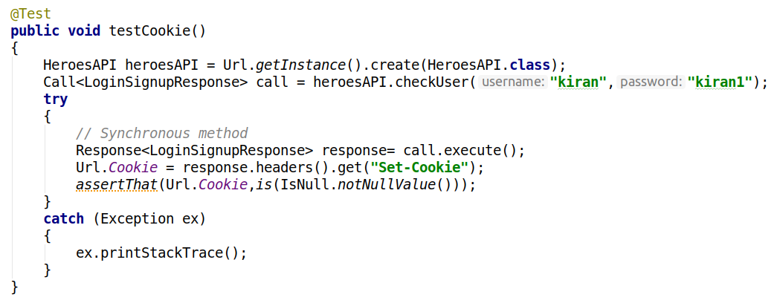
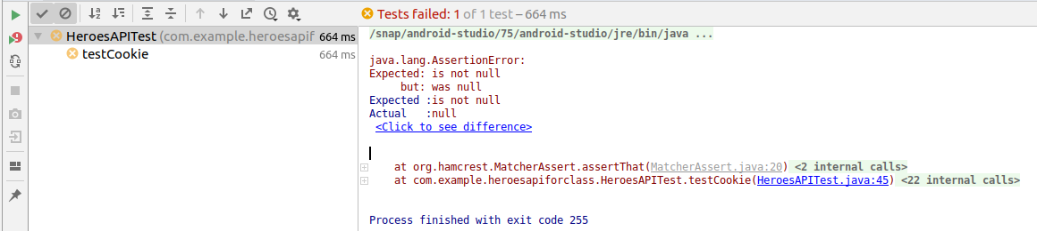
Failed test without class
Output

Slide 53
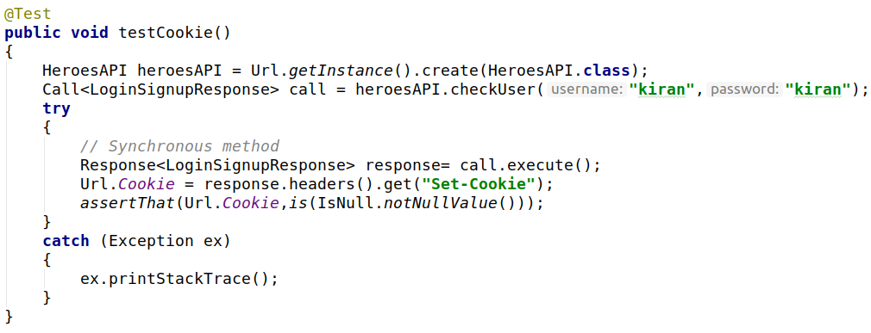
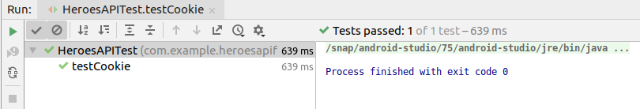
Passed Test without class
Output

Slide 54
Do not write business login in activity class.

Slide 55
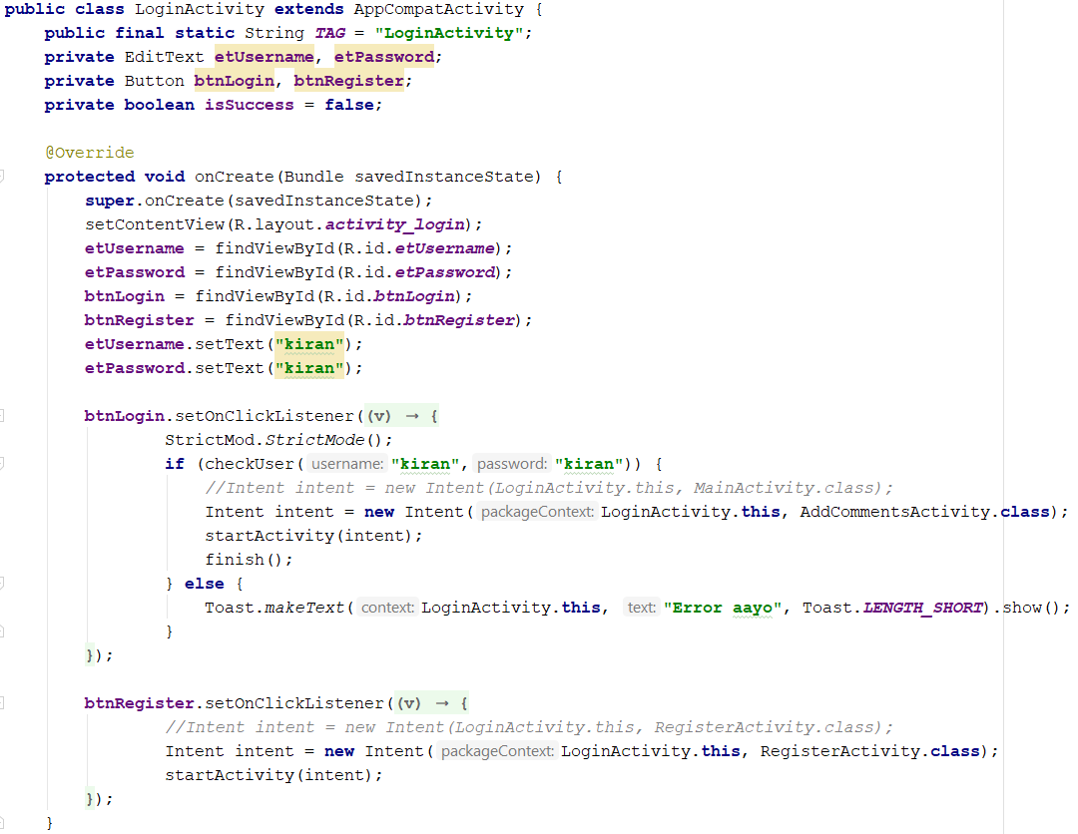
Login activity without class

Slide 56
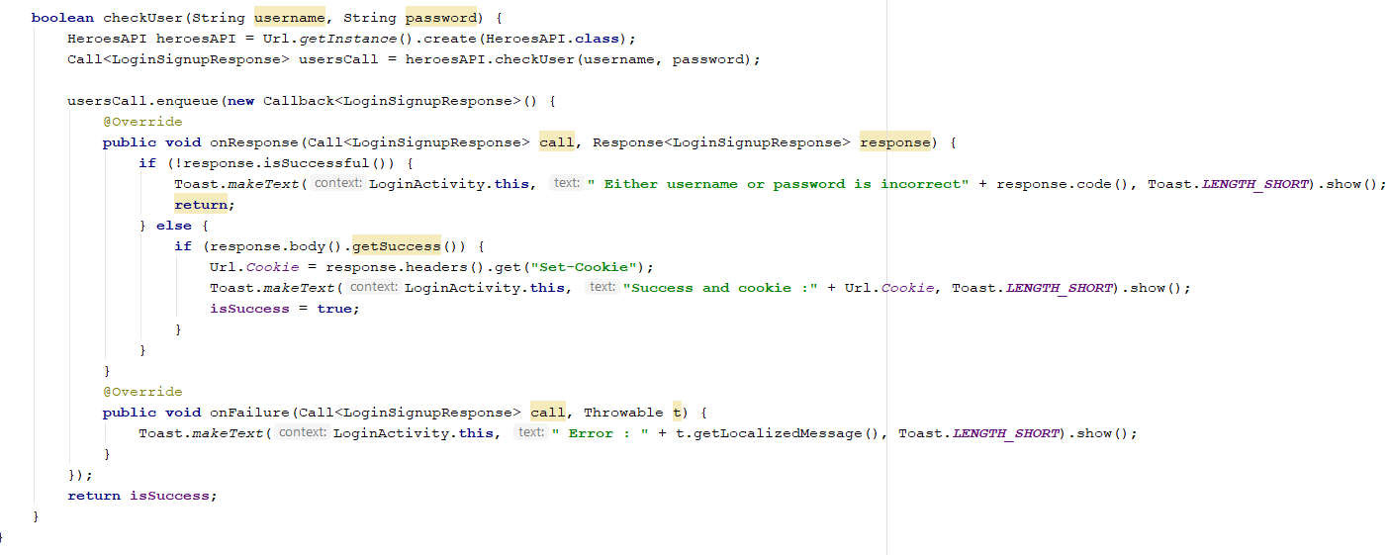

Slide 57
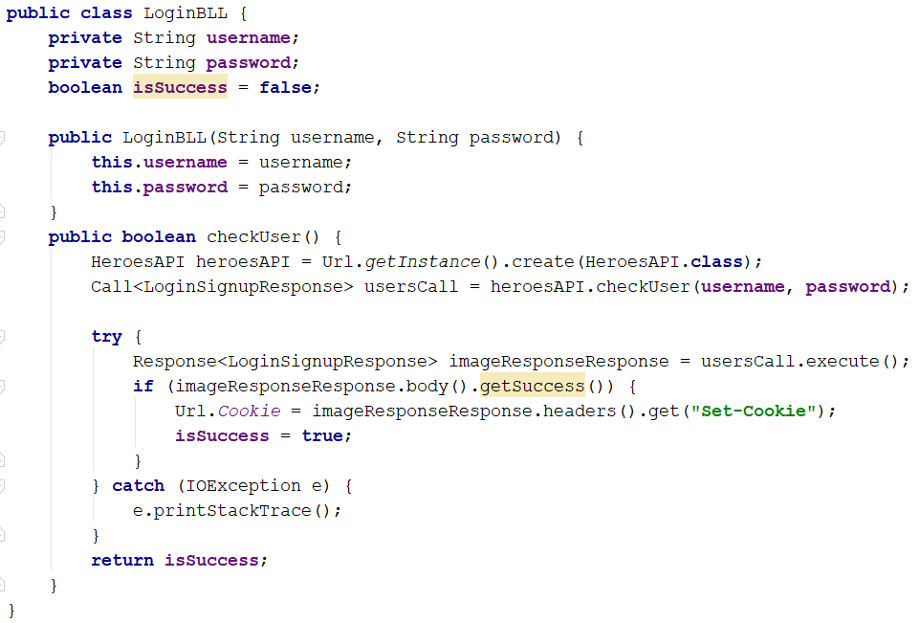
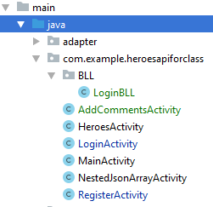

Slide 58
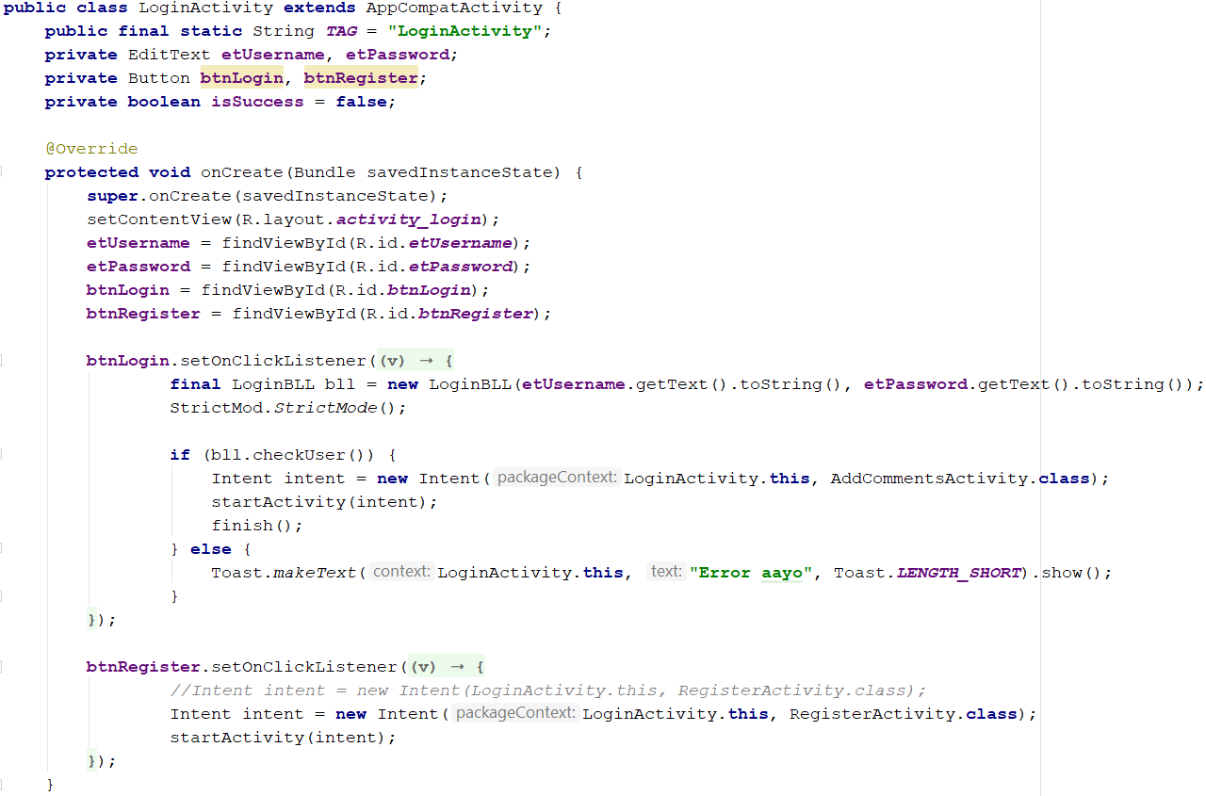
Login Activity

Slide 59


Testing Login Function

Slide 60

Run test with coverage

Slide 61
Classwork
Add another class for Register user and write a test for this class.

